Slide 1
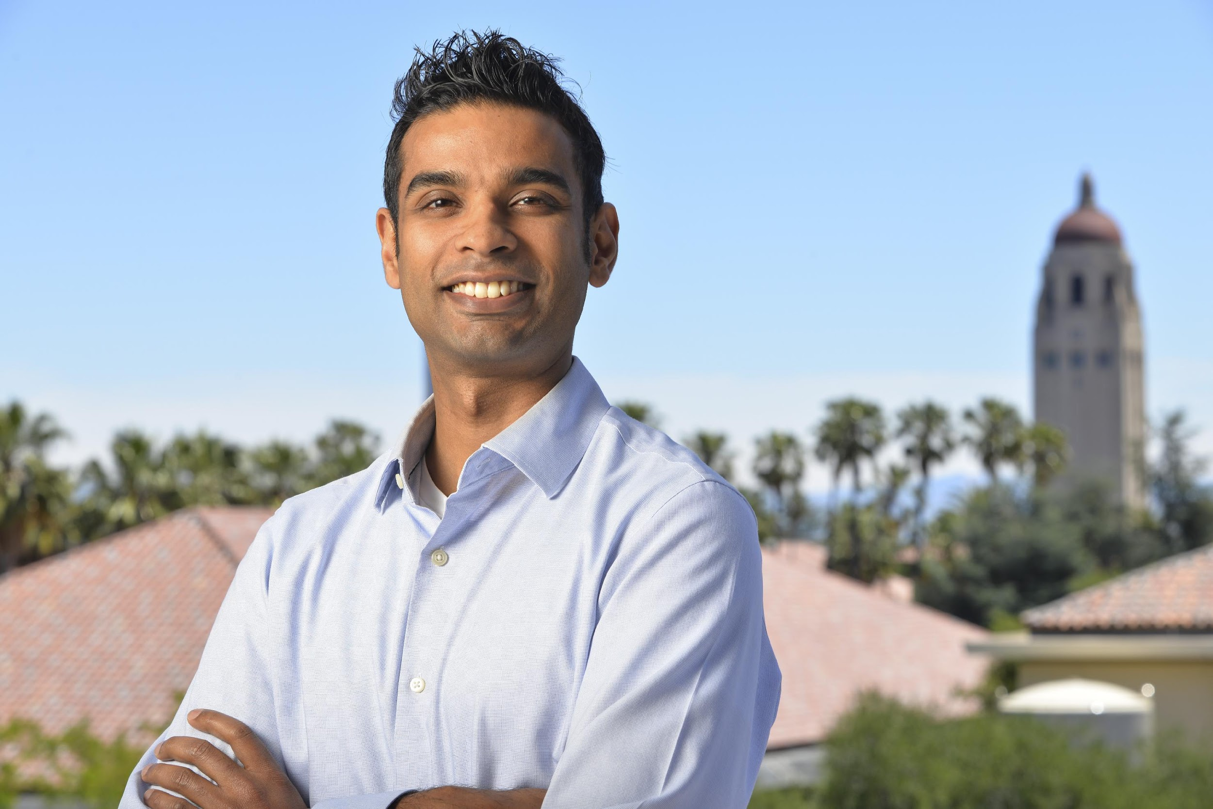
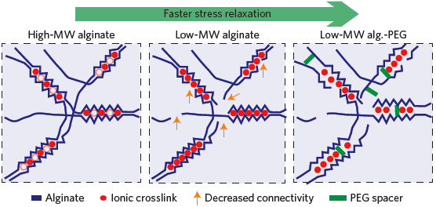
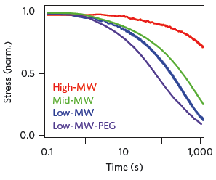
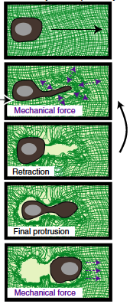
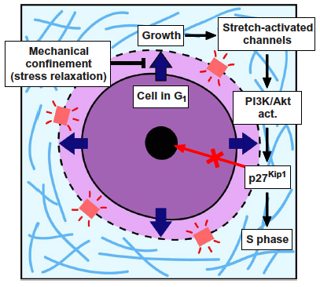
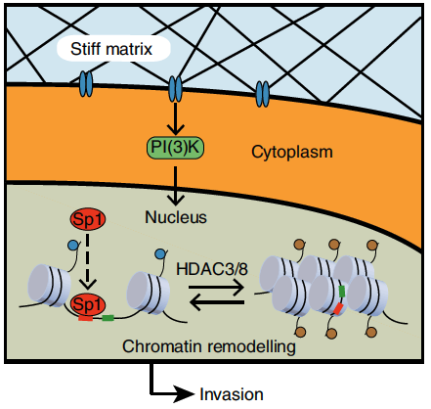
Ovijit Chaudhuri
Mechanical Engineering
Stanford University
Chaudhuri lab for cell biophysics and mechanotransduction
Engineered biomaterials with tunable mechanical properties for 3D cell culture
Elasticity (stiffness)
Viscoelasticity (stress relaxation)
Mechanical plasticity
Impact of matrix viscoelasticity on cells
Increased matrix stiffness and breast cancer progression
How do cells migrate and divide in confining matrices?
Broad changes in the epigenome mediate impact of altered stiffness
Matrix viscoelasticity impacts cell- cycle progression
Mechanical plasticity mediates protease- independent migration

Slide 2
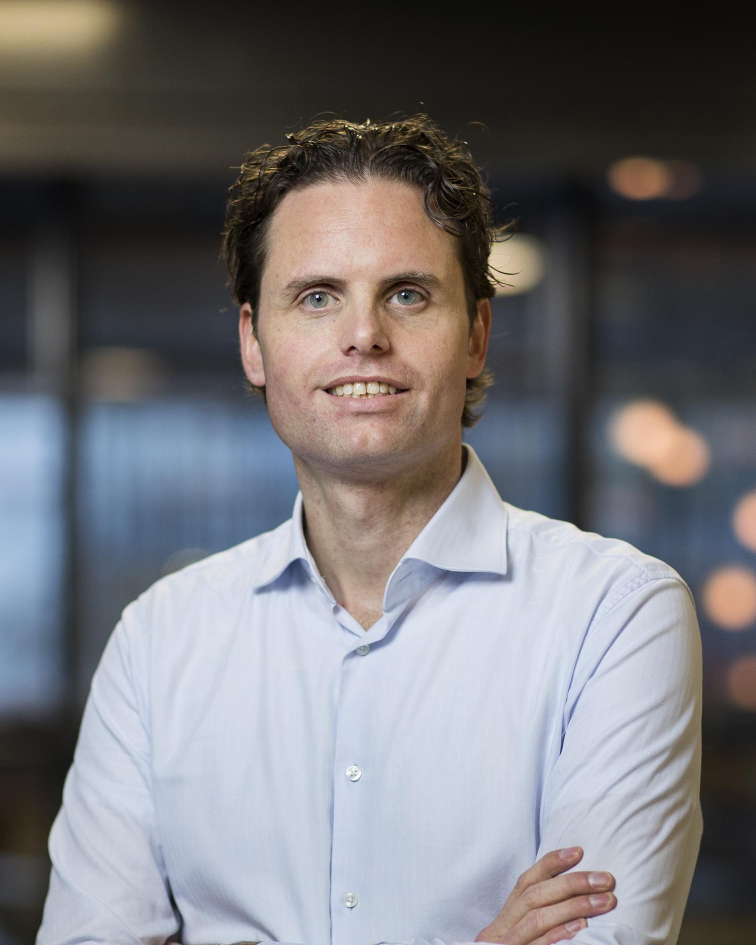


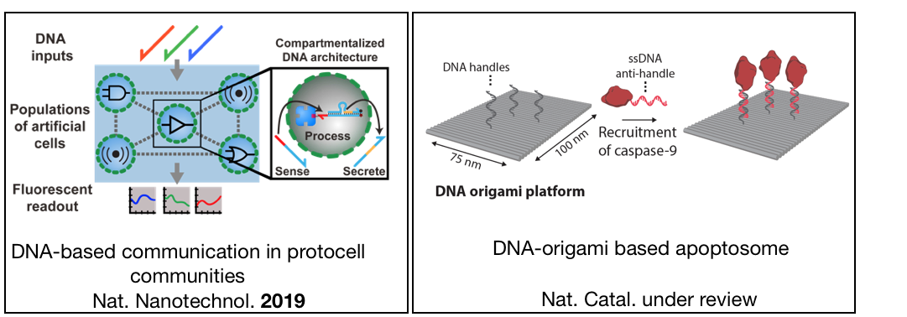
Tom de Greef
Eindhoven University of Technology
Lab’s research focus
Development of autonomous molecular information processing systems with new modes of molecular computation and data storage/retrieval
DNA nanotechnology as a biophysical tool
How to do this with non-biological molecules?
@tfadgreef
t.f.a.d.greef@tue.nl
Nat. Nanotechnol. 2019
Nat. Catal. In press

Slide 3
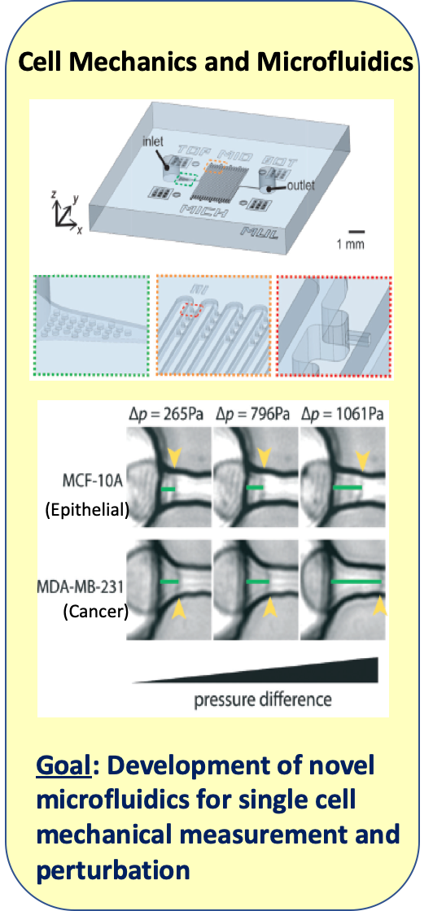
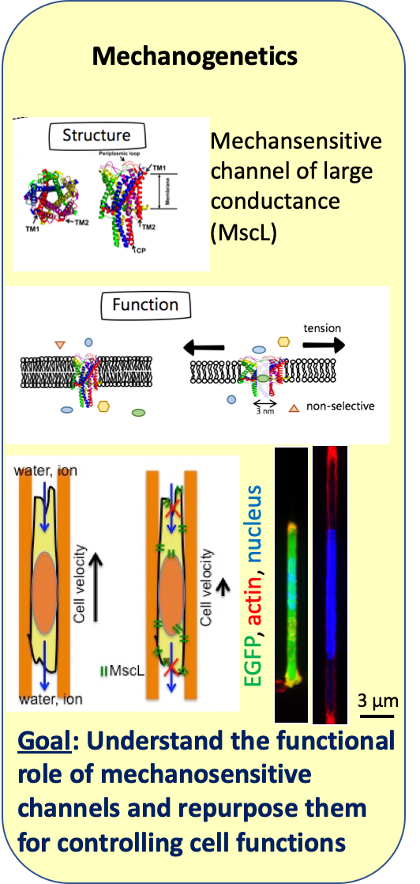
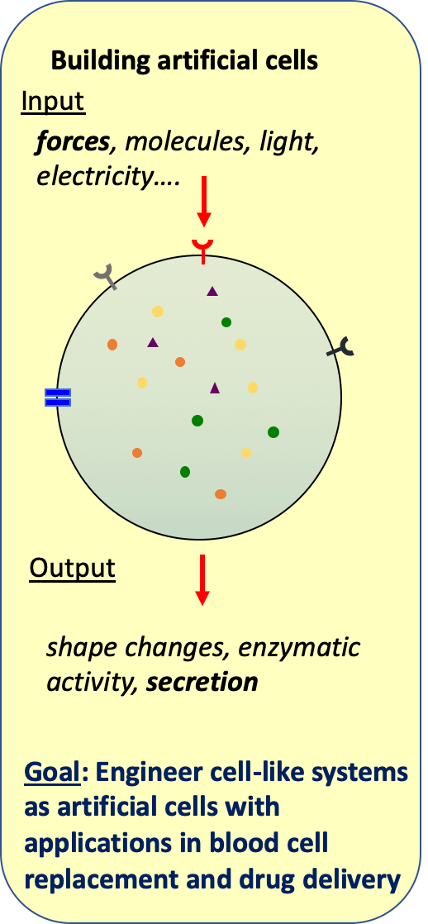
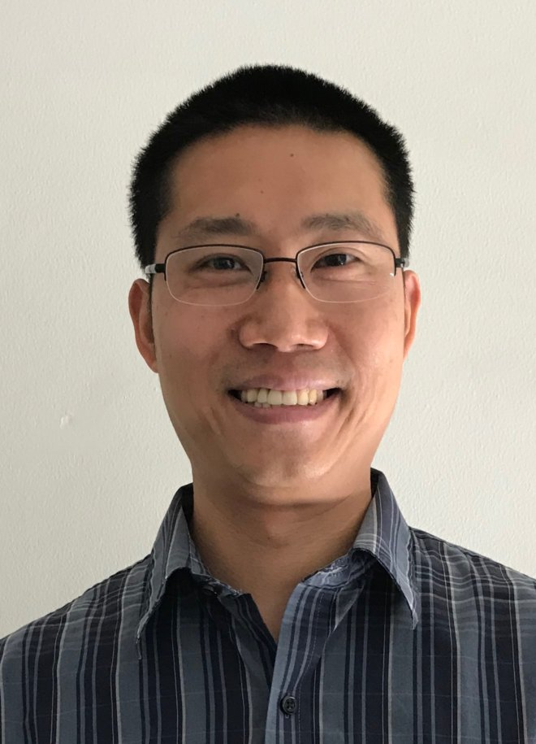
Allen Liu
Mechanical Engineering
University of Michigan

